Slide 1
PyS60: Last Leg
Feb 15, 2007

Slide 2
Callbacks
Useful for asynchronous operations.
Doing processes in background such as precomputation.
Check the PyS60 API documentation to see which functions allow for callback.

Slide 3
Process Flow Without Callback
Execute until completion
method foo(callback=None)
After completion or after exception is raised
next code segment
…
Synchronous Process

Slide 4
Process Flow With Callback
Execute until completion in background
method foo(callback=finishOp)
Run other code
(usually done until callback executes and the state changes)
After completion or after exception is raised
Invoke callback finishOp with an errorcode (0 = no error) as argument.
Asynchronous Process

Slide 5
Callback Example
def update():
do some computation on the image…
global finished
finished=0
def finishload(err):
global finished
finished=1
loaded_image.load(selected_file, callback=finishload)
…
while not finished:
update()

Slide 6
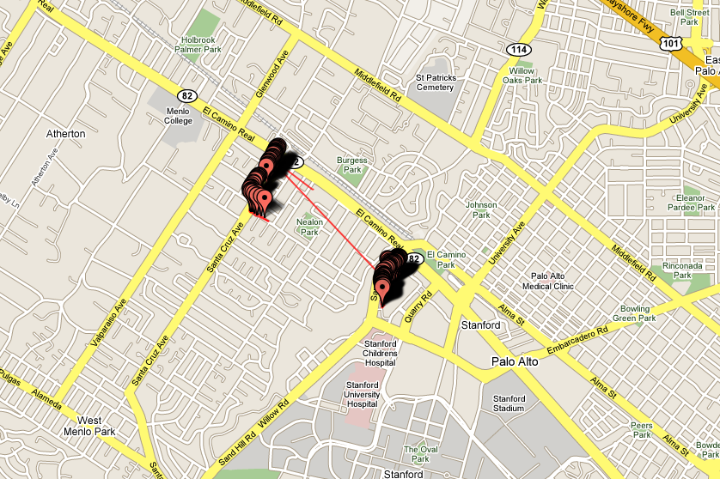
Geotagging via PyS60

Slide 7
Geotagging via PyS60
Convert data into gpx format which more GPS visualizer softwares use.
www.gpsvisualizer.com
www.robogeo.com

Slide 8
Assignment 4
(Due Feb 22 2007 11:59 pm)
Submit a report (.doc or .pdf) <= 4 pages on your experiences and thoughts on location-aware applications for phones. Report should include the following:
  Introduction
  Motivation of the problem
  Related work – products and research
  Example applications
  Discussion and conclusion

Slide 9
Assignment 4 - Resources
Try out Yahoo! Research’s Zonetags (need a data plan for your phone)
http://zonetag.research.yahoo.com/
http://www.teemuharju.net/fupper
Sample papers (download from class web site)

Slide 10
PyS60 Wrapup
Setting up python for your phone
  Emulator
  NCF
UI controls – appuifw
messaging, networking
bluetooth
audio
graphics and camera

